Slide 1
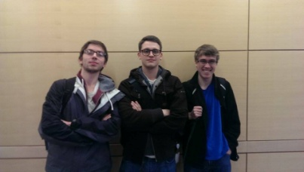
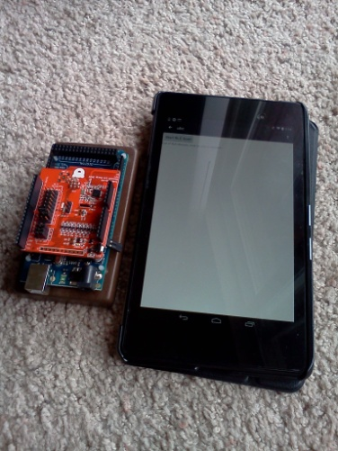
Bluetooth Hardware Controller
CS Capstone Projects
“Control your world through bluetooth”
Sean Penney, penneys@onid.oregonstate.edu
Aaron Egger, eggera@onid.oregonstate.edu Paul Atkinson atkinspa@onid.oregonstate.edu Client: Don Heer, heer@eecs.oregonstate.edu
Introduction and Background
Doing The Project
Results
We wanted more experience designing user interfaces and working with bluetooth devices in Android.
Don Heer wanted a framework to allow general users to control hardware through bluetooth without programming. Advanced users could create the software modules for specific bluetooth hardware. This project was a collaboration between our CS senior project group and an ECE senior project group. Collaboration allowed us to utilize hardware that wouldn’t have been available otherwise.
We learned about bluetooth low energy and different profiles.
For the plugin framework, we made each plugin into an .apk file which can be downloaded from the website. The main app can figure out which plugins are installed, and launch any of them.
Later we will fill in more material here.
In this section we will talk about how the project went. This will be filled in later.
Graphs, charts, imagery
Graphs, charts, imagery
Diagram of framework
Project Description
Conclusions
We setup a framework to create modules, along with a website where modules can be uploaded/downloaded.
List steps later
We used our framework to develop some modules for a bluetooth gamepad, keyboard, and Arduino.
We chose bluetooth low energy to minimize battery usage, and learn new technologies.
Conclusion will be filled in later
Importance
Control of bluetooth devices can be consolidated by using this app. This will allow people to automate household items .
12-1-14

